Slide 1

Data Analytics Lesson 4 Cloud Computing Environment
Jeffrey Strickland, Ph.D.

Slide 2

What is Required by Data Analytics?
Integrate
Analyze
Visualize
V1 | V2 | V3 | V4
1 | 14.23 | 1.71 | 2.43
1 | 13.20 | 1.78 | 2.14
1 | 13.16 | 2.36 | 2.67
1 | 14.37 | 1.95 | 2.50
1 | 13.24 | 2.59 | 2.87

Slide 3

Platforms
Azure (Microsoft)
Amazon Web Services (AWS)
Google Cloud Service
100101011
01010101
0011011100
11100100011
010101101010
01010101
0011011100
11100100011
010101101010
01010101
0011011100
11100100011
010101101010

Slide 4
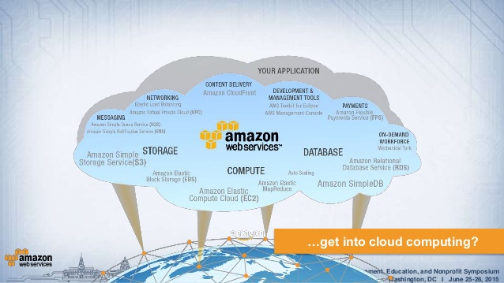
Amazon - Nimbostratus

Slide 5
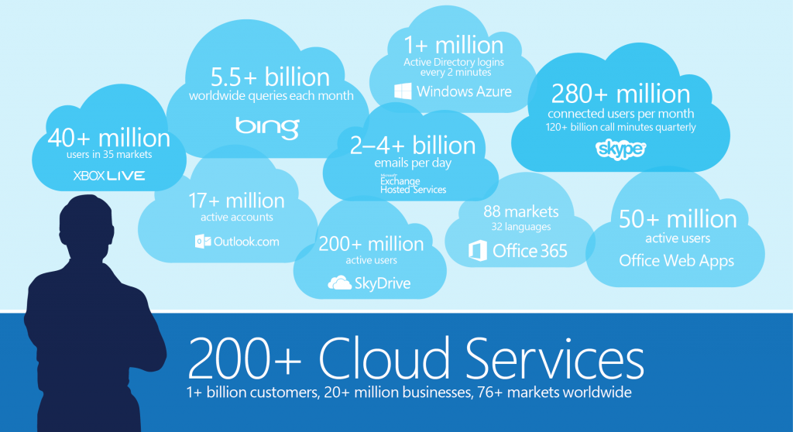
Azure - Cumulus

Slide 6
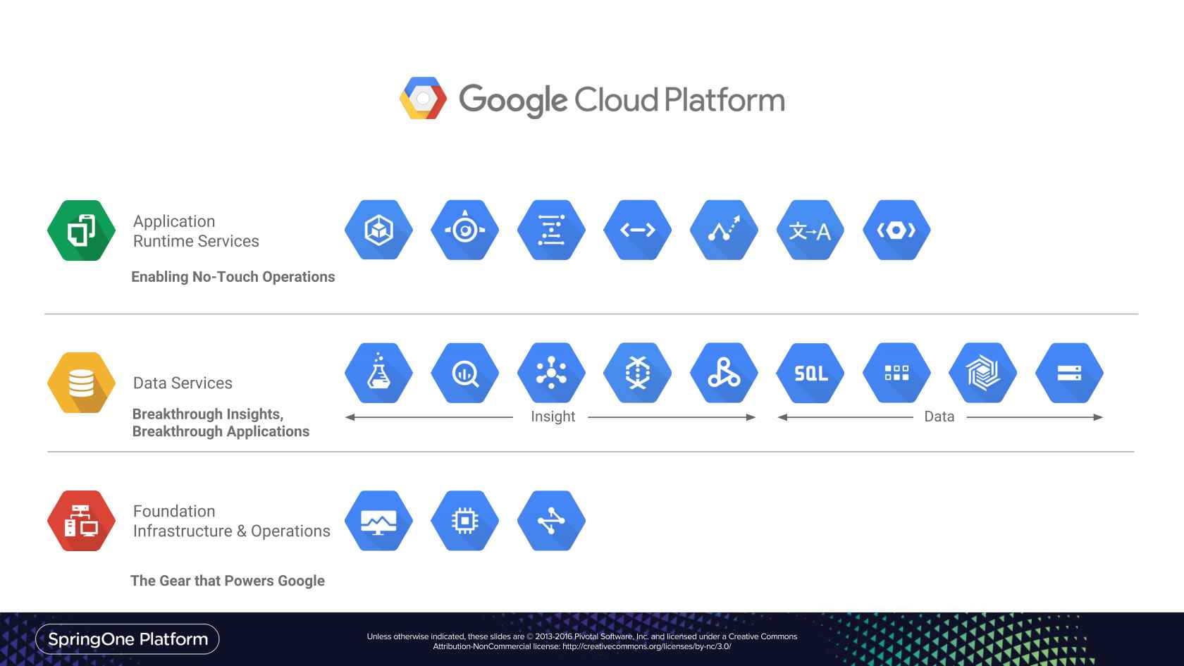
Google - Stratus

Slide 7
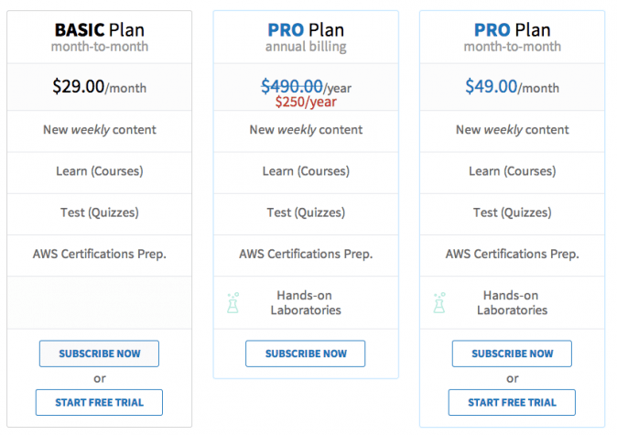
Amazon – Free Trial

Slide 8
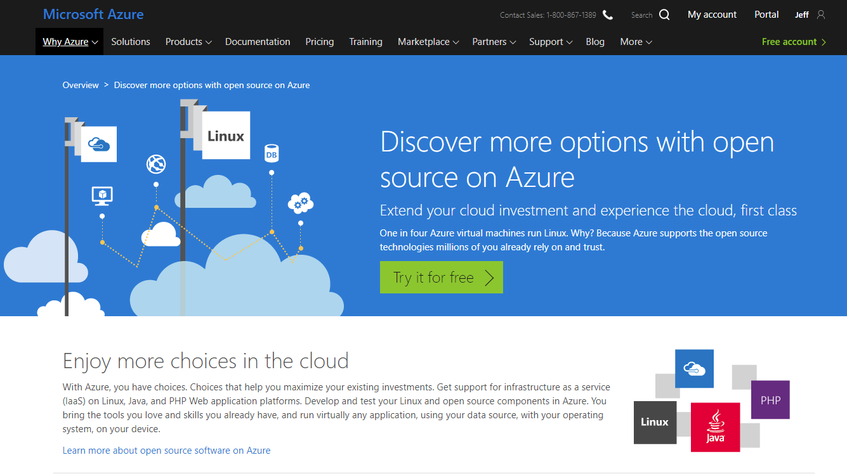
Azure – Free Trials

Slide 9
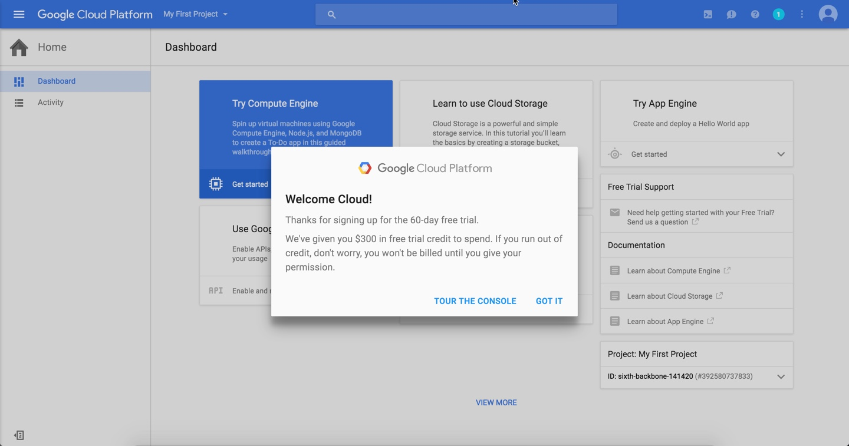
Google – Free Trial

Slide 10
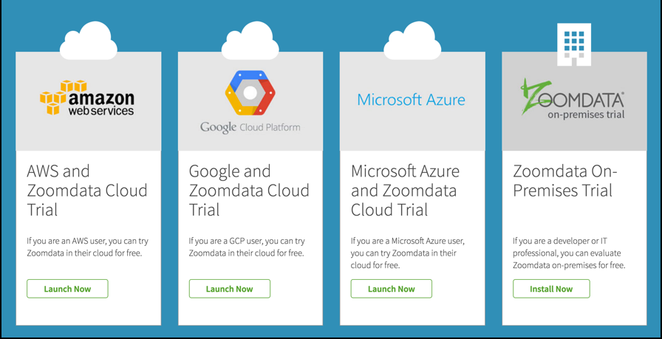
Cloud Compositions - Zoomdata

Slide 11
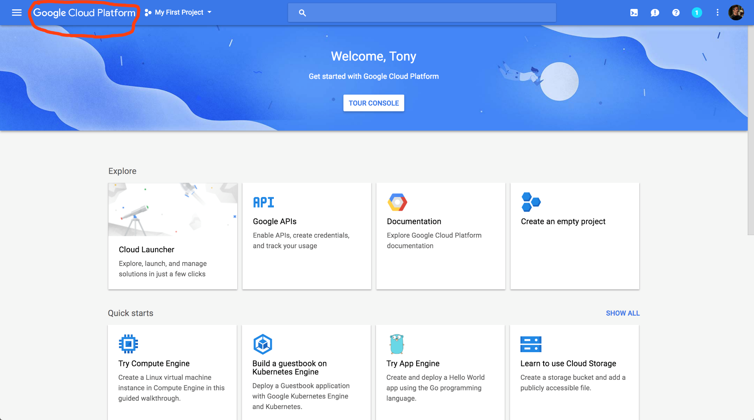
Google Cloud Environment

Slide 12
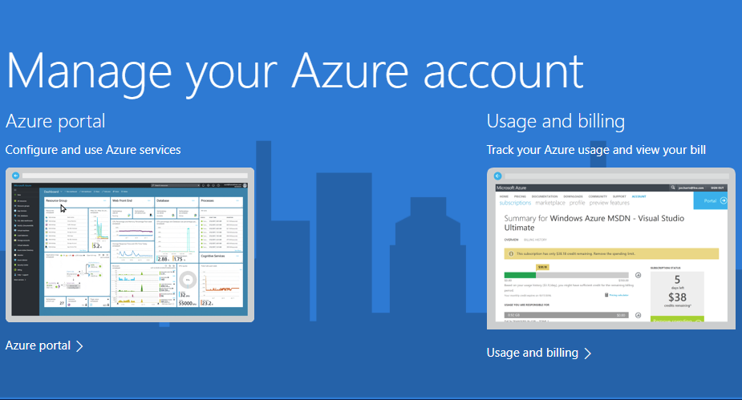
Account Management

Slide 13
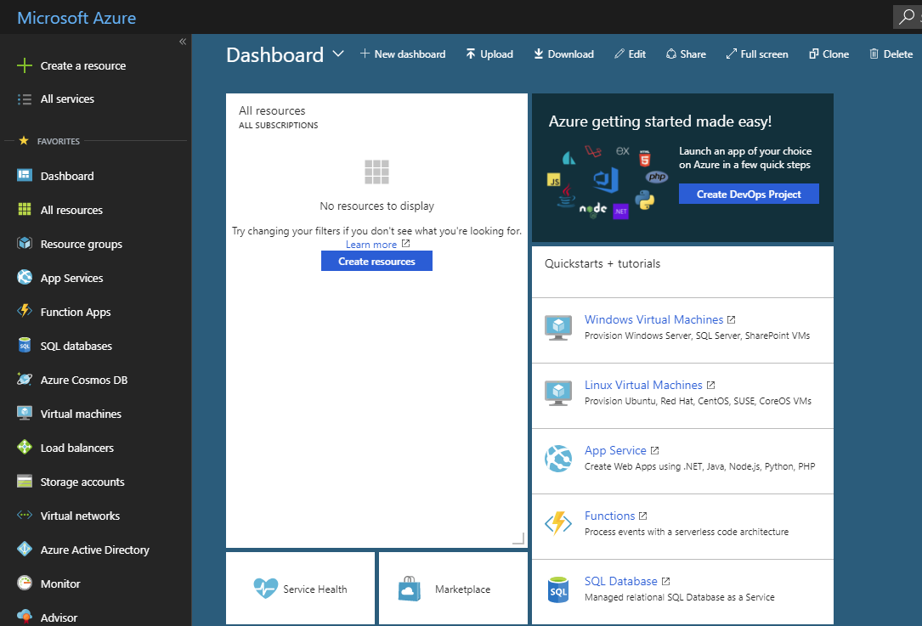
Resource Management

Slide 14
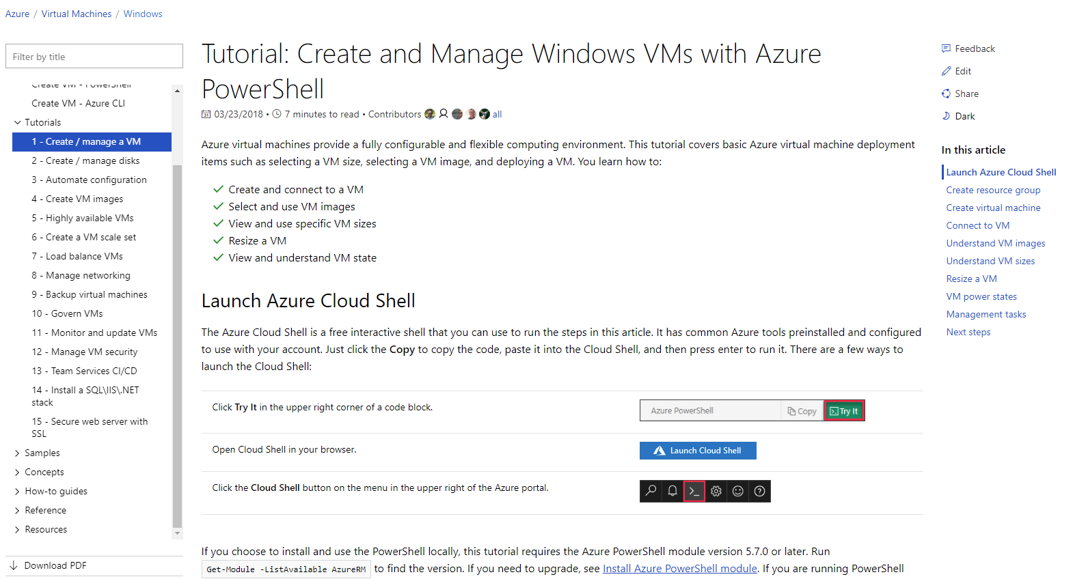
Built-in Tutorials

Slide 15
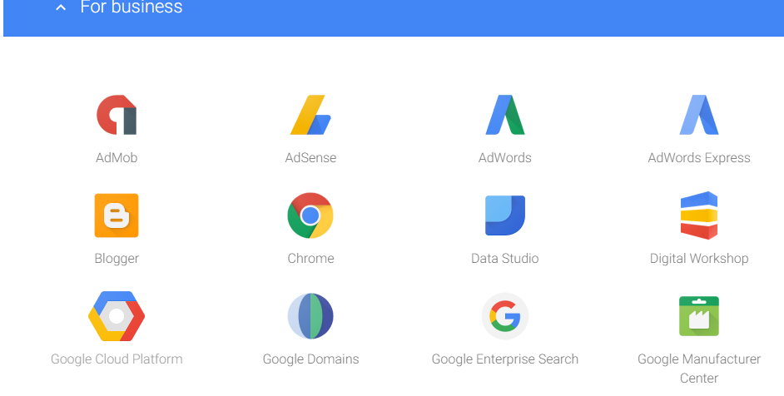
Google Web Services

Slide 16
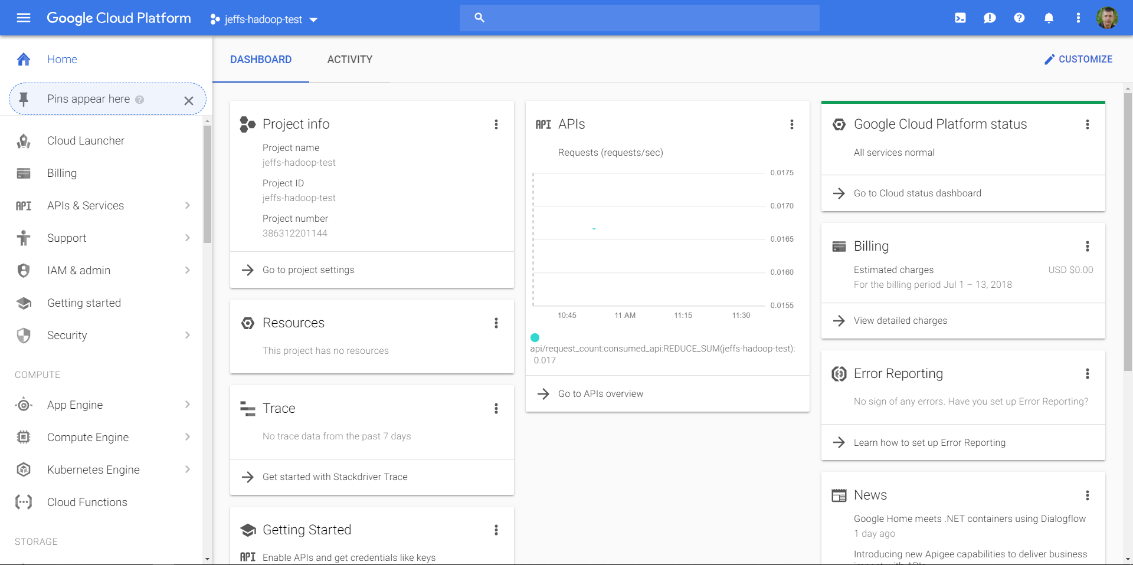
Google Cloud Platform

Slide 17
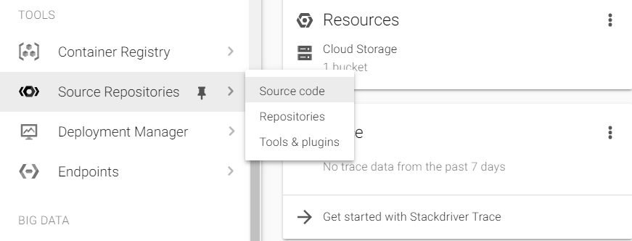
Google Cloud Tools
Storage
APIs
Coding
Tools
Models (ML)

Slide 18
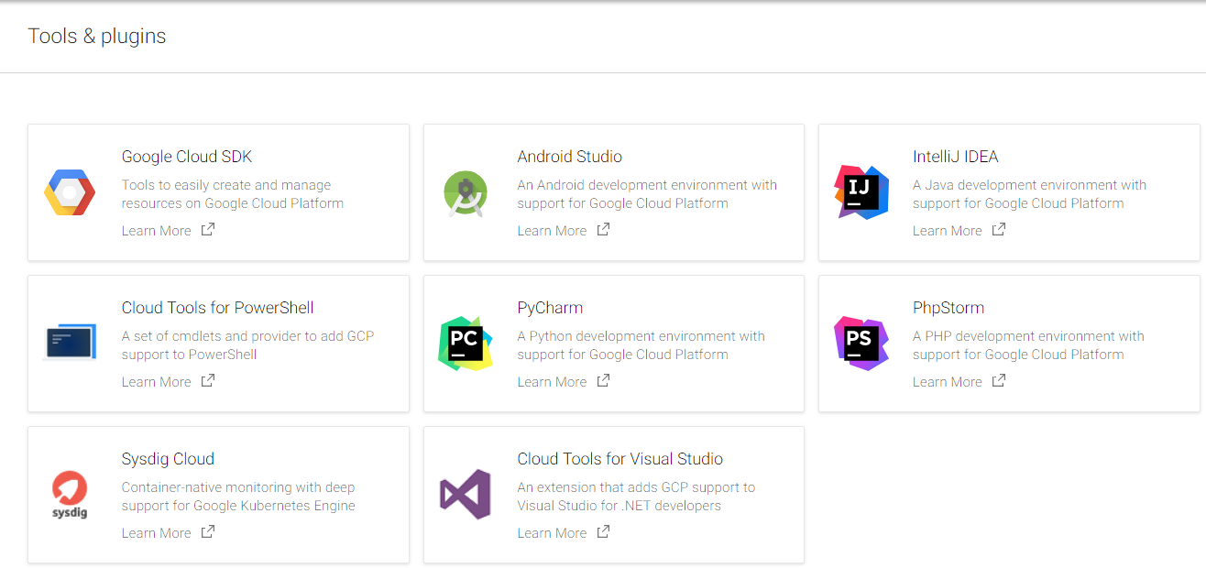
Google Cloud Tools and Plugins

Slide 19
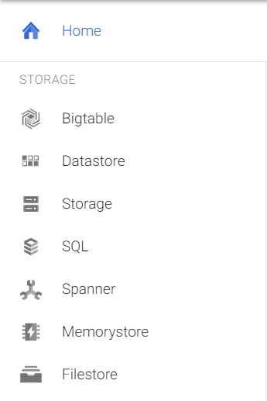
Google Cloud Storage
SQL
Datastore
Filestore
Others

Slide 20
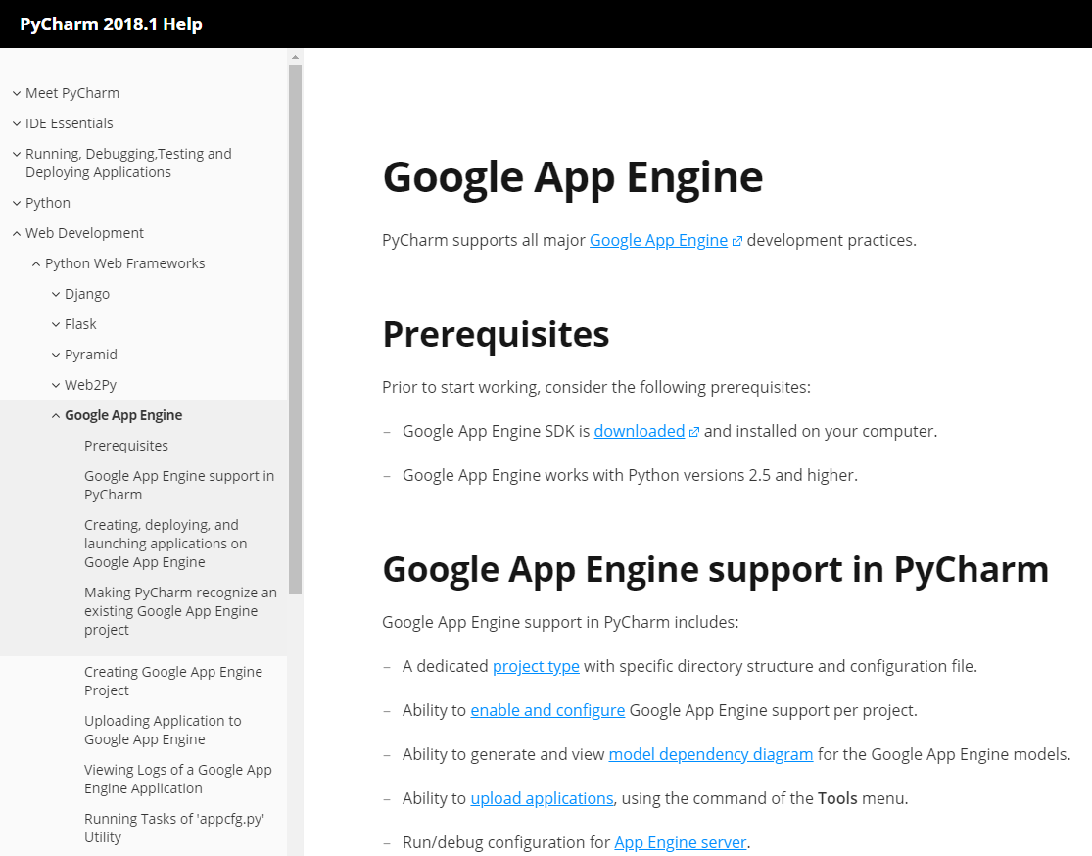
Google App Engine
Project Type
Google Apps
Upload Apps
Model dependency
App Engine Server

Slide 21
Example - Azure
Azure virtual machines provide a fully configurable and flexible computing environment. This tutorial covers basic Azure virtual machine deployment items such as selecting a VM size, selecting a VM image, and deploying a VM. You learn how to:
Create and connect to a VM
Select and use VM images
View and use specific VM sizes
Resize a VM
View and understand VM state

Slide 22
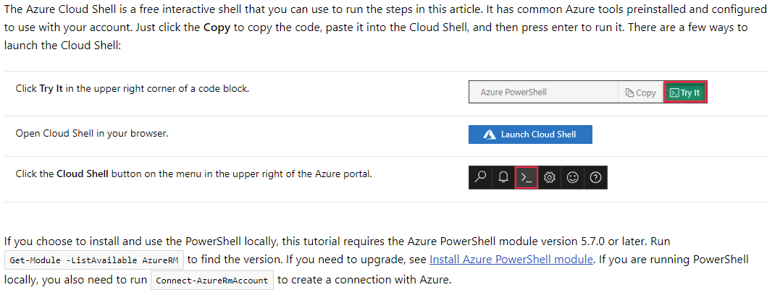
Launch Azure Cloud Shell

Slide 23
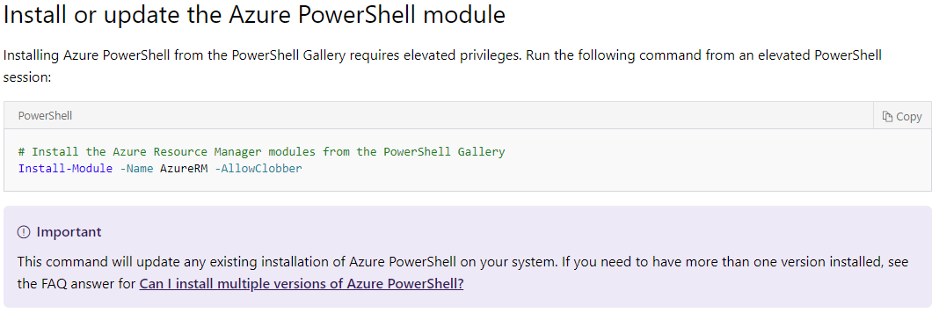
Install Azure PowerShell with PowerShellGet

Slide 24
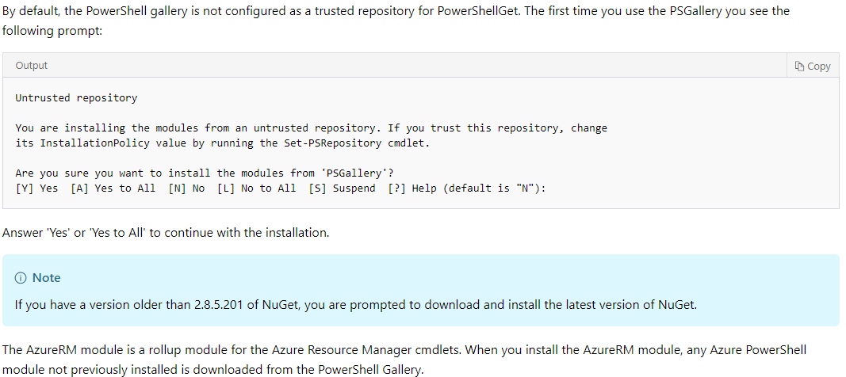
Powershell configuration

Slide 25
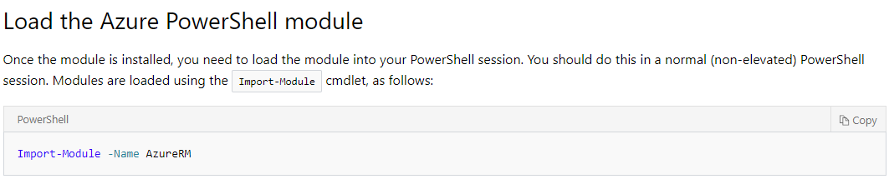
Powershell Module

Slide 26
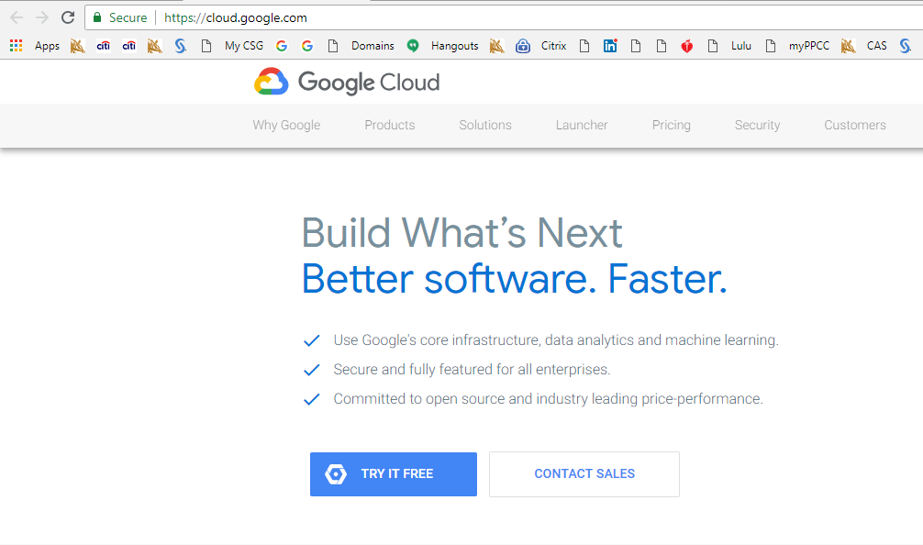
Google Cloud Free Trial

Slide 27
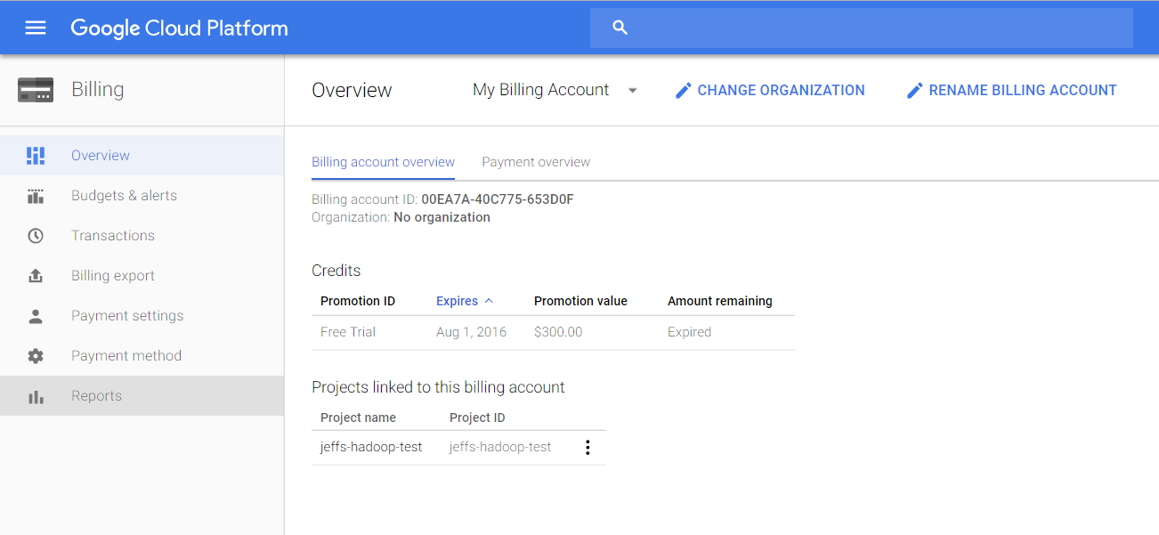
Google Cloud Platform Promotion

Slide 28
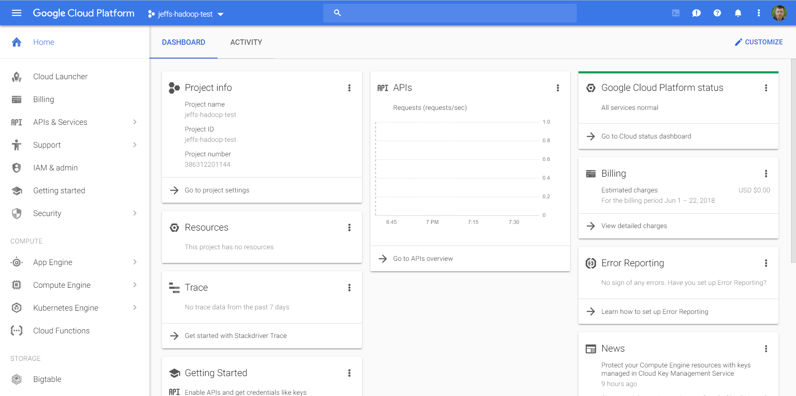
GOOGLE CLOUD Dashboard

Slide 29
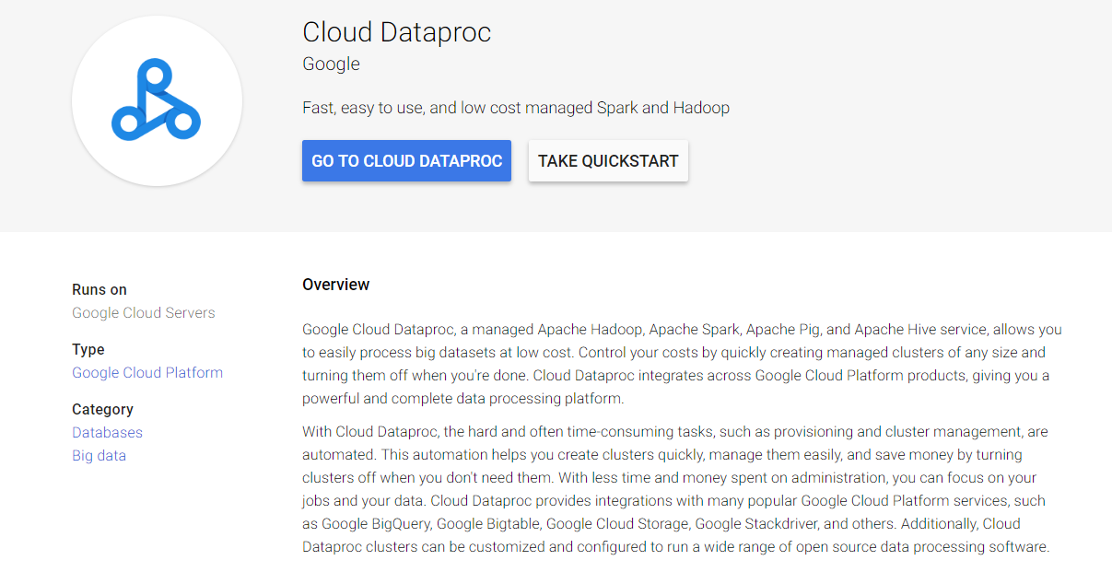
Hadoop Machine – Cloud Dataproc

Slide 30
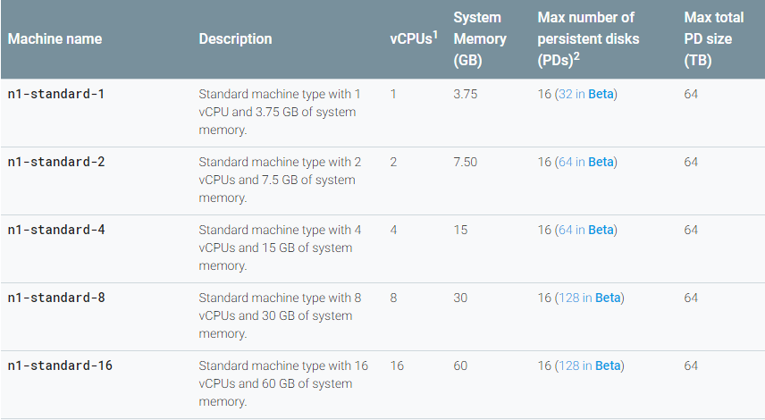
Standard Machine Descriptions

Slide 31
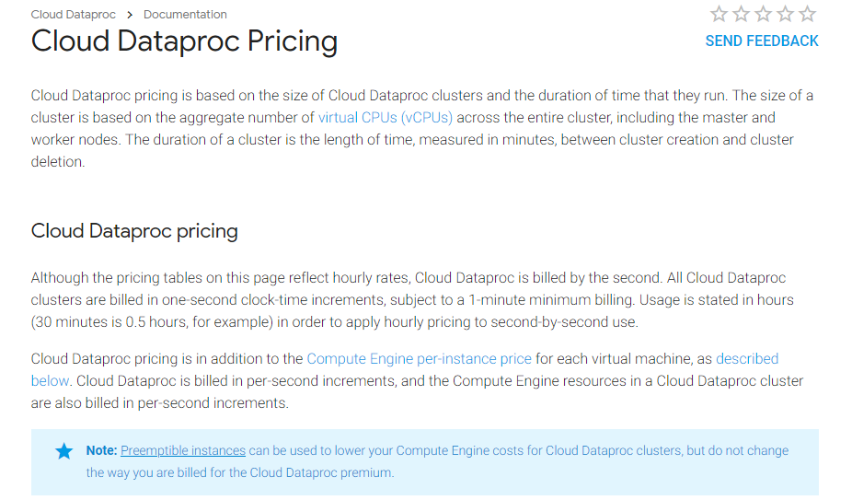
Cloud Dataproc Pricing

Slide 32
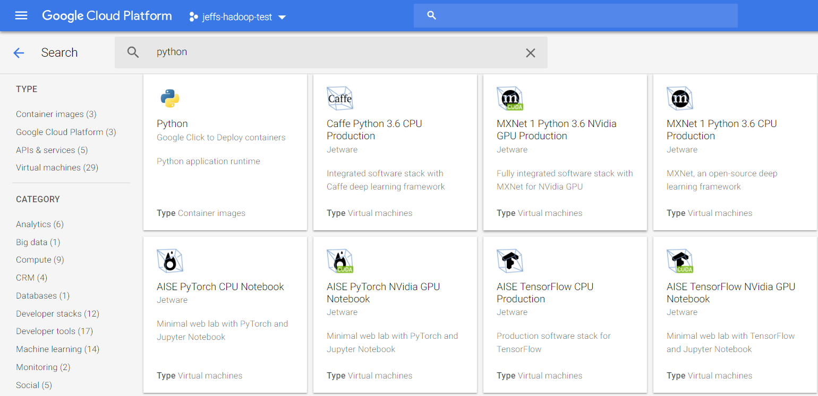
Python Search

Slide 33
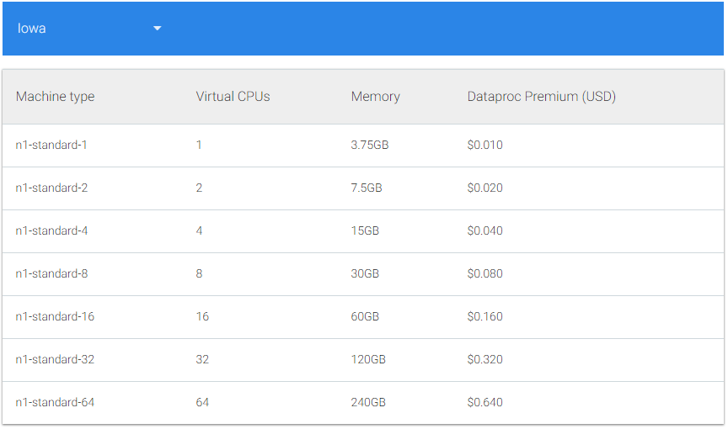
Notebook - Jupyter

Slide 34
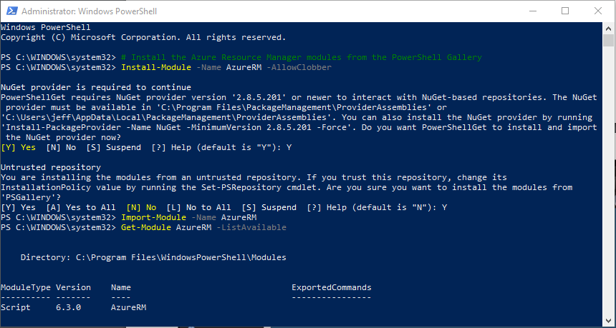
Windows Powershell

Slide 35
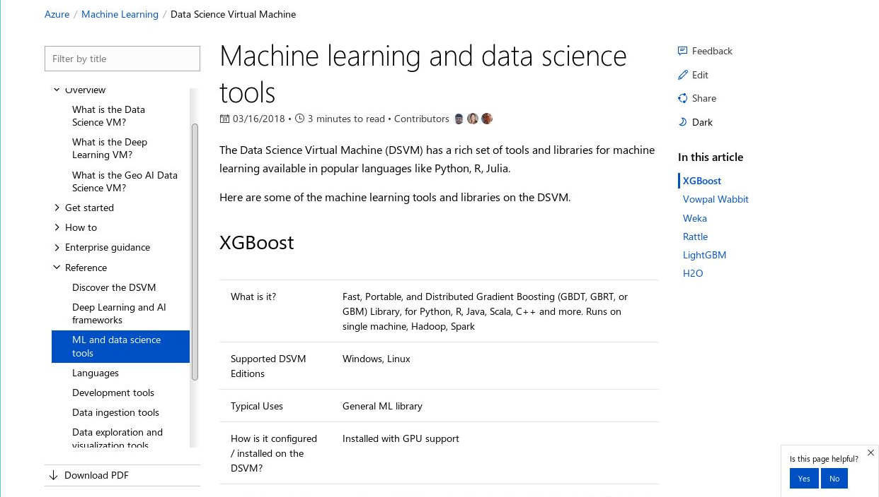
Data Science Tools

Slide 36
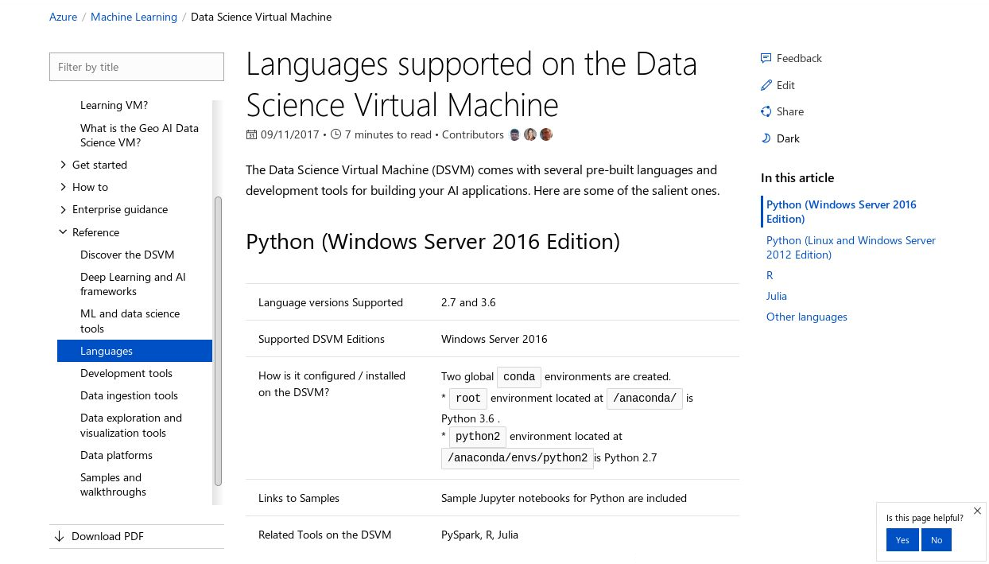
DATA Science Virtual Machine (DSVM)

Slide 37
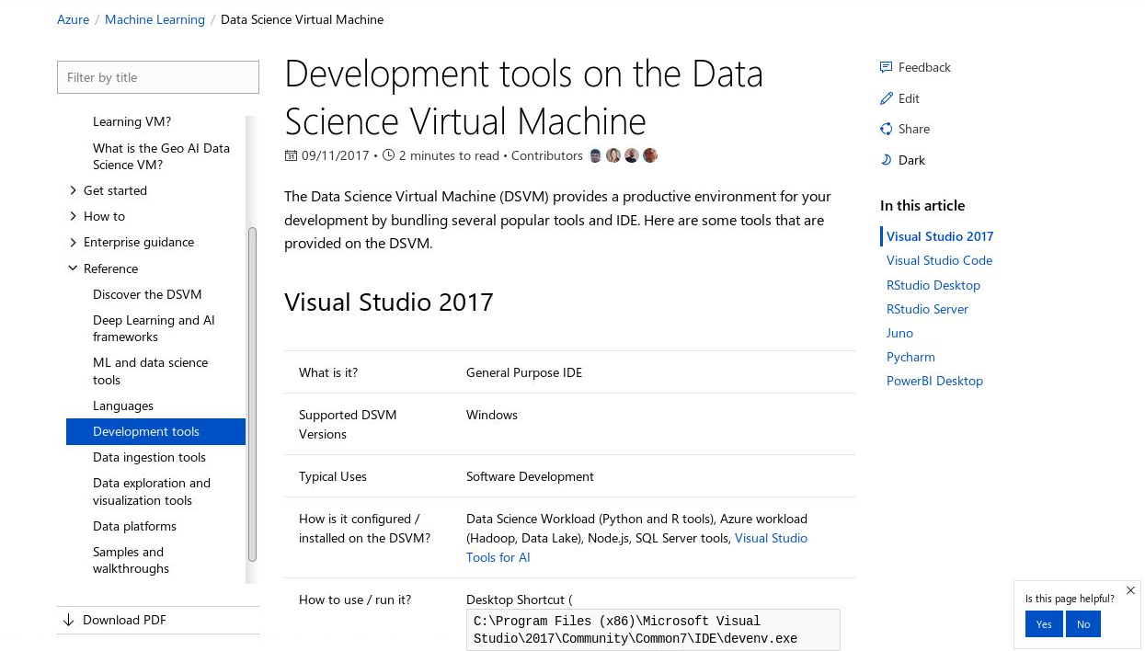
DSVM Configuration

Slide 38
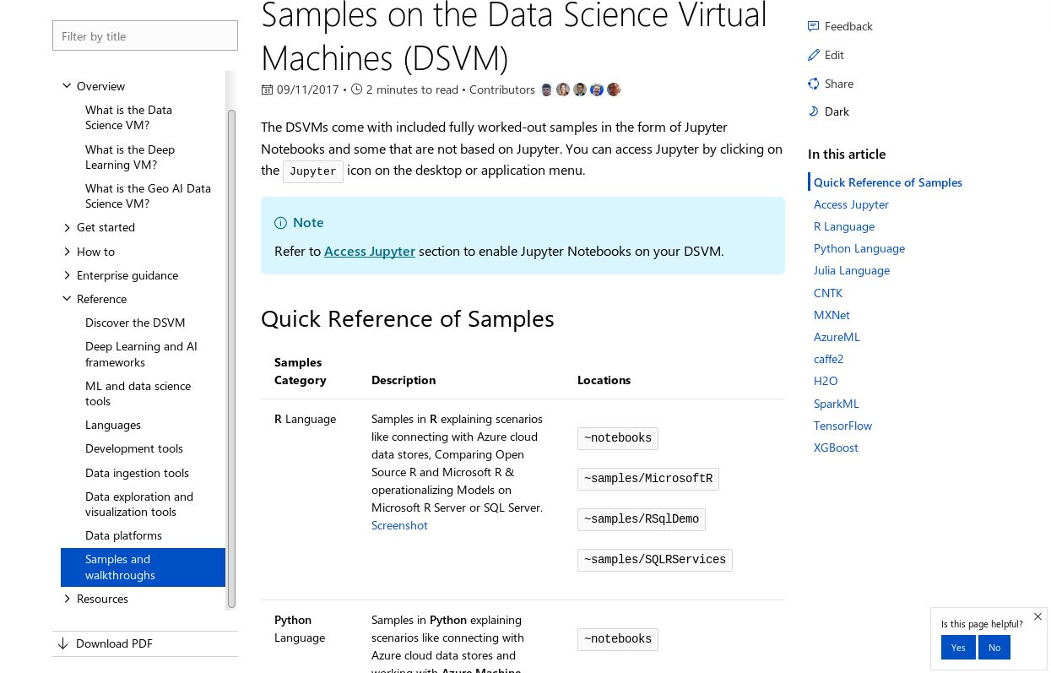
Samples on the DSVM

Slide 39

Hadoop Clusters
A cluster is a group of servers and other resources that act like a single system and enable high availability, load balancing and parallel processing.
Hadoop clusters are a special type of computational cluster designed specifically for storing and analyzing huge amounts of unstructured data in a distributed computing environment.
Such clusters run Hadoop's open source distributed processing software on low-cost commodity computers.
Hadoop clusters are often referred to as "shared nothing" systems because the only thing that is shared between nodes is the connecting network.

Slide 40
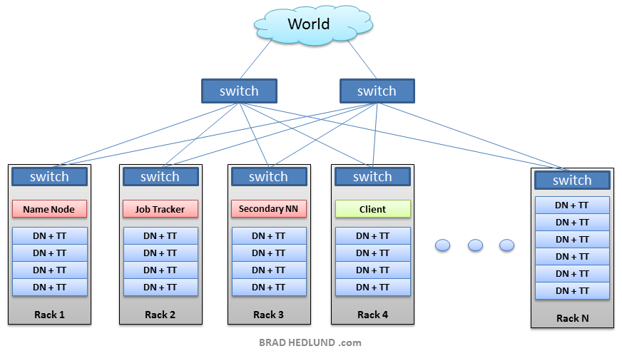
What are Hadoop Instances?
Cluster
Sart with a VM
Racks
Nodes
Name Node¹
Data Node
Job Tracker
Task Tracker
Client
Switches
Cluster
Core Switch
Core Switch
8 GB
8 GB
16 GB
8 GB
8 GB
1. NameNode tries to place replicas of Data Nodes on multiple racks for improved fault tolerance

Slide 41
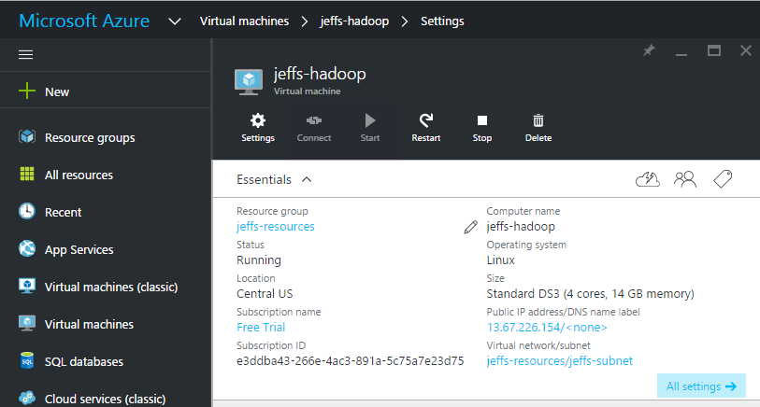
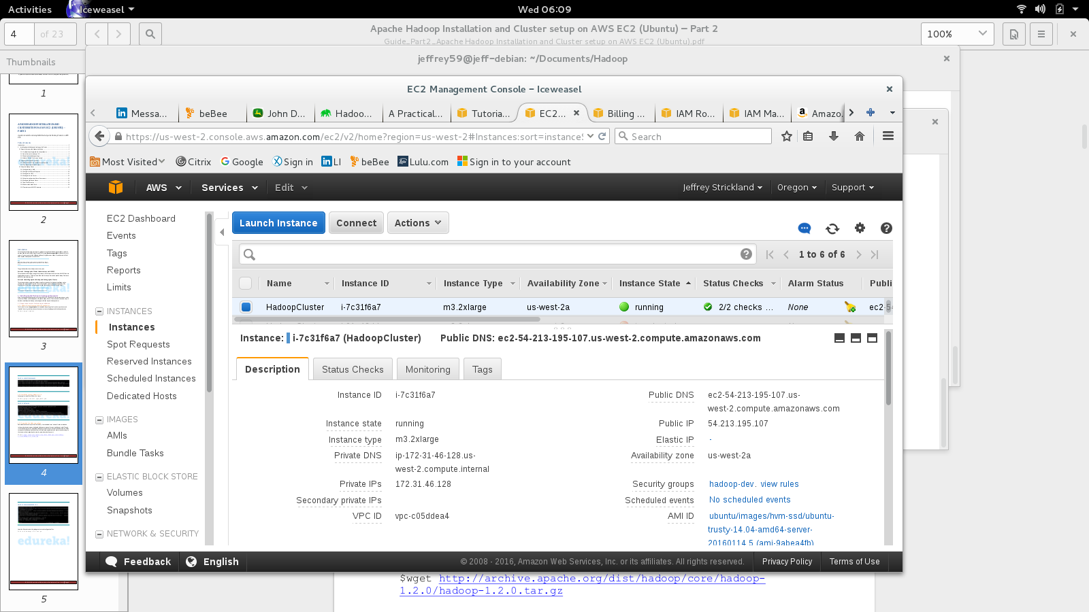
Example Hadoop Instances?
Microsoft Azure
Very Stable
User Friendly
Free version
Google Web Services
Google Analytics
Non intuitive setup
Trial version
Amazon Web Services (AWS)
Unstable
Non intuitive setup
Trial Version

Slide 42
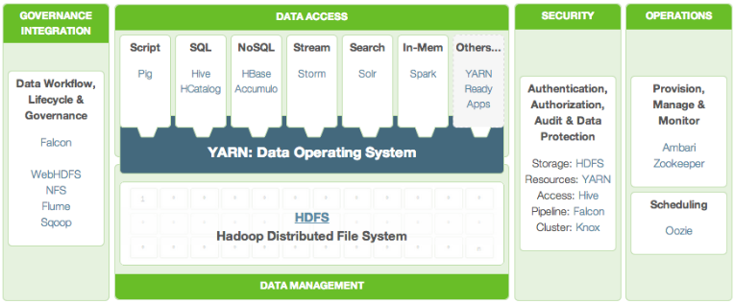
Hadoop High-Level Architecture Overview
Containers for application / programs
Application / programs
Application / programs
Application / programs
Application / programs
Security groups
OS
File System

Slide 43
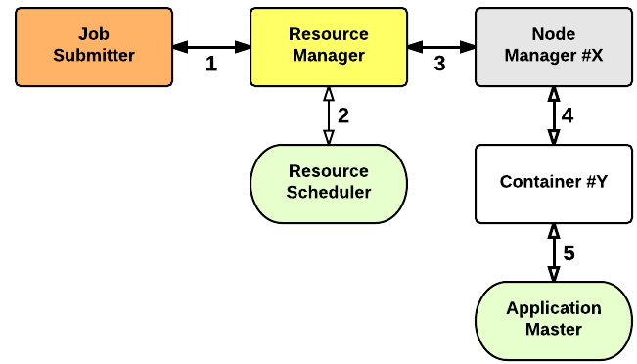
What is the Application Startup Process?
a client submits an application to the Resource Manager
the Resource Manager allocates a container
the Resource Manager contacts the related Node Manager
the Node Manager launches the Container
the Container executes the Application Master
the Application Master submits the application

Slide 44
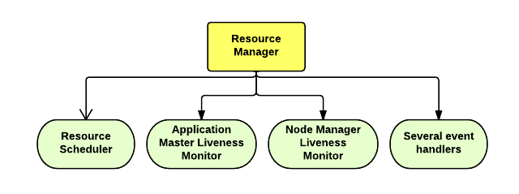
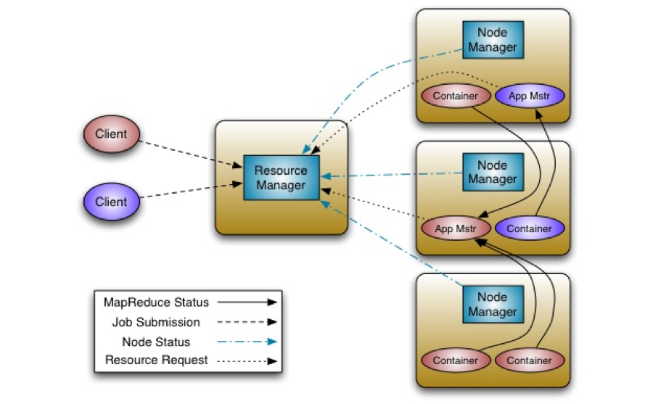
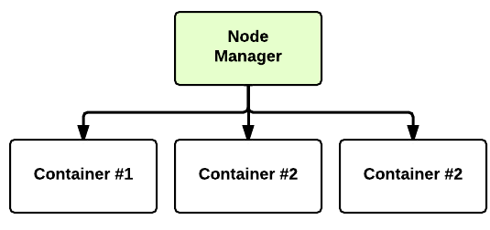
What is the Core of Hadoop Architecture?
Resource Manager
(one per cluster)
Node Manager
(many per cluster)
A Container is a fraction of the NM capacity and it is used by the client for running a program.

Slide 45
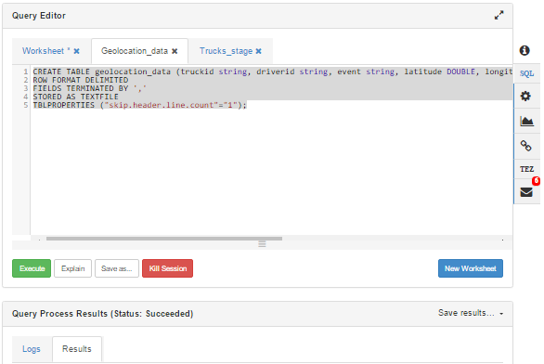
Example Application – Hive Query

Slide 46
References
Ghemawat, Sanjay; Gobioff, Howard; Leung, Shun-Tak. "The Google File System".
Dean, Jeffrey; Ghemawat, Sanjay. "MapReduce: Simplified Data Processing on Large Clusters".
Cutting, Doug (28 Jan 2006). "new mailing lists request: hadoop". issues.apache.org.The Lucene PMC has voted to split part of Nutch into a new sub-project named Hadoop

Slide 47
Contact Information
E-mail: jeff@humalytica.com
LinkedIn: https://www.linkedin.com/in/jeffreystrickland
Web site: www.humalytica.com
Skype: jeffrey.strickland2

Slide 48
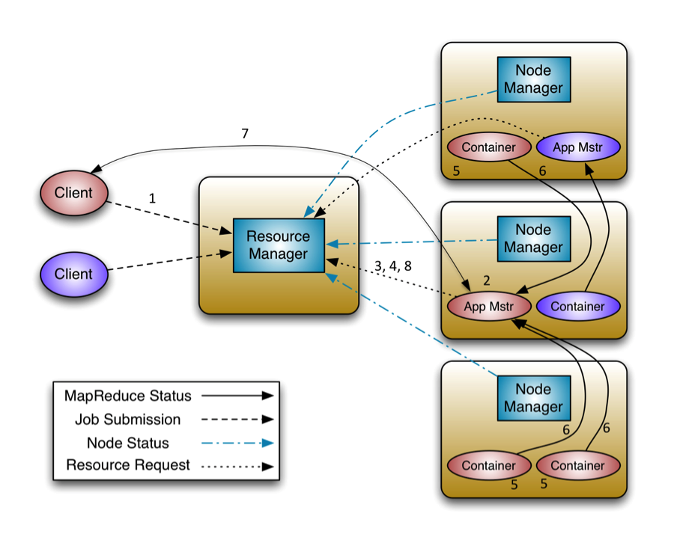
What is the Application Master?
A client program submits the application, including the necessary specifications to launch the application-specific ApplicationMaster itself.
The ResourceManager assumes the responsibility to negotiate a specified container in which to start the ApplicationMaster and then launches the ApplicationMaster.
The ApplicationMaster, on boot-up, registers with the ResourceManager – the registration allows the client program to query the ResourceManager for details, which allow it to directly communicate with its own ApplicationMaster.
During normal operation the ApplicationMaster negotiates appropriate resource containers via the resource-request protocol.
On successful container allocations, the ApplicationMaster launches the container by providing the container launch specification to the NodeManager.
The application code executing within the container then provides necessary information (progress, status etc.) to its ApplicationMaster via an application-specific protocol.
During the application execution, the client that submitted the program communicates directly with the ApplicationMaster to get status, progress updates etc. via an application-specific protocol.
Once the application is complete, and all necessary work has been finished, the ApplicationMaster deregisters with the ResourceManager and shuts down, allowing its own container to be repurposed.

